Slide 1

Chest X-ray Classification
Unlocking insights from pixels, our AI breathes life into every X-ray frame, shaping a healthier tomorrow with each classification

Slide 2
Why Image classification
Our innovative approach, utilizing HOG feature extraction and custom CNN models, accurately discerns pneumonia presence from chest CT X-ray images, offering early detection potential.
Beyond binary classification, this method could aid in subtype differentiation and optimize resource allocation, while contributing valuable insights for monitoring disease trends.

Slide 3
LIBRARIES USED
TensorFlow: For building and training deep learning models.
Keras: High-level neural networks API (backed by TensorFlow) for easy model development.
Scikit-learn: For model evaluation and metrics calculation.
Matplotlib: For data visualization.
Glob2: For file handling and directory operations.

Slide 4
PIPELINE
Data Collection
Preprocessing
Model Training
Evaluation
Deployment
Chest X-ray images were sourced from diverse repositories, including public medical databases and hospital archives, ensuring a comprehensive dataset representing various demographics and clinical conditions.
Data preprocessing involved artifact removal, irrelevant information elimination, augmentation (rotation, flipping), and pixel value scaling for consistent normalization across images.
During training, Convolutional Neural Networks (CNNs) were selected for image classification tasks and optimized using algorithms like Adam or RMSprop for improved parameter adjustment.
Model performance was rigorously assessed via cross-validation to prevent overfitting, ensuring generalizability, with metrics like accuracy, precision, recall, and F1-score for precise classification evaluation.
Potential deployment strategies involve creating a user-friendly interface for image uploads, integrating the model into PACS, or deploying it as a cloud-based diagnostic tool, with regular updates to maintain accuracy and relevance in clinical practice.

Slide 5
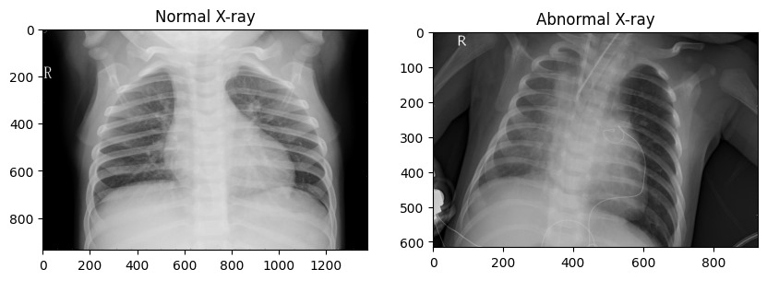
Data Exploration
Our dataset comprises
chest X-ray images
categorized into normal
and pneumonia classes. We conducted exploratory data analysis, including:
- Displaying sample images from the dataset.

Slide 6
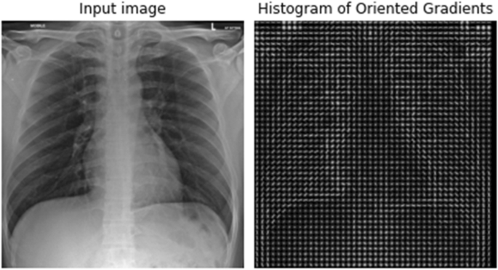
Visualizing the distribution of pixel intensities through histograms.

Slide 7
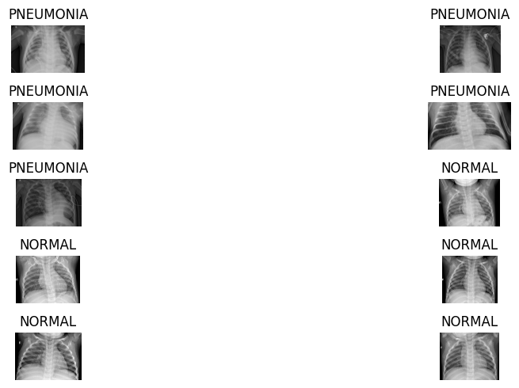
Data Preprocessing
Prior to model training, we preprocessed the data by:
- Resizing images to a uniform size (224x224 pixels).
- Performing data augmentation techniques such as rotation, shearing, and flipping (if applicable).
- Normalizing pixel values to a range between 0 and 1.

Slide 8
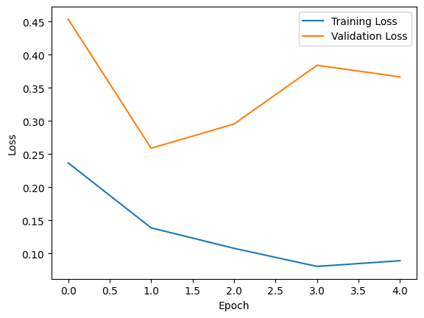
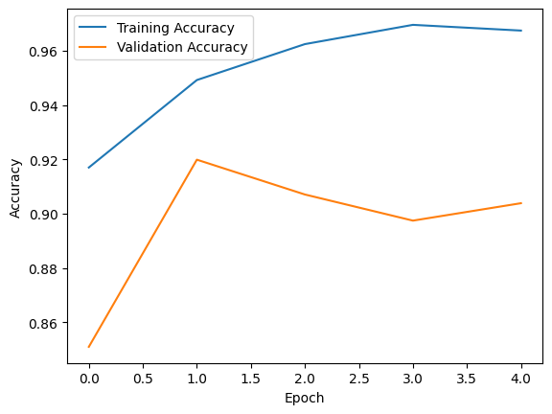
Model Training
We compiled the model with categorical cross-entropy loss and the Adam optimizer. The data was fed into data generators for efficient processing. We trained the model using the fit() function, monitoring training and validation loss/accuracy over epochs.
---

Slide 9
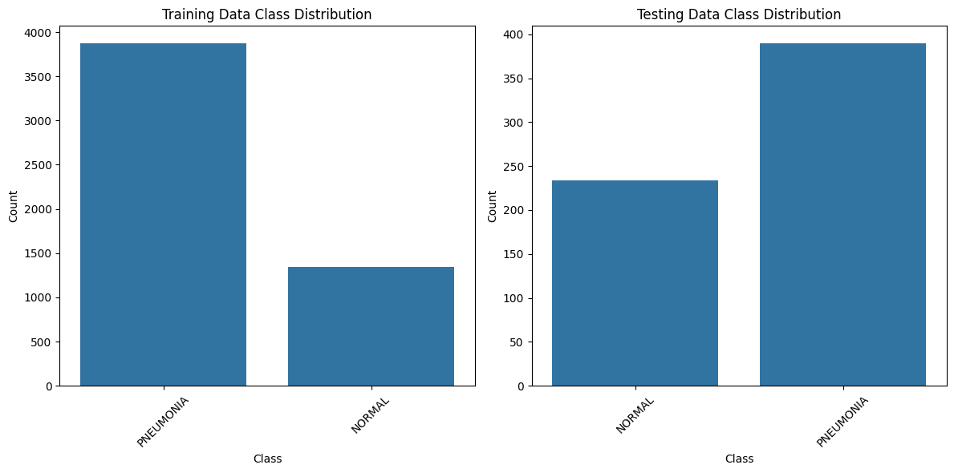
Visualizing the distribution of Training & Testing intensities through histograms.

Slide 10
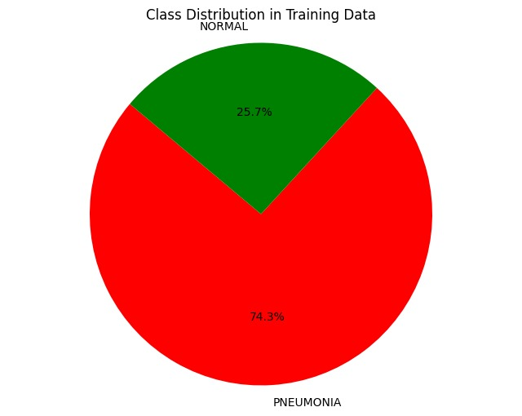
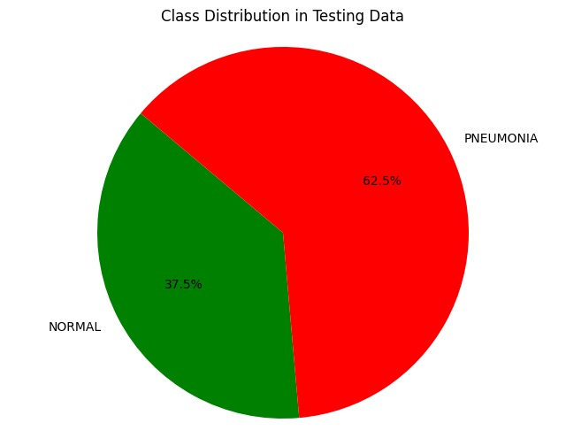
- Analyzing class distribution using a pie chart.

Slide 11
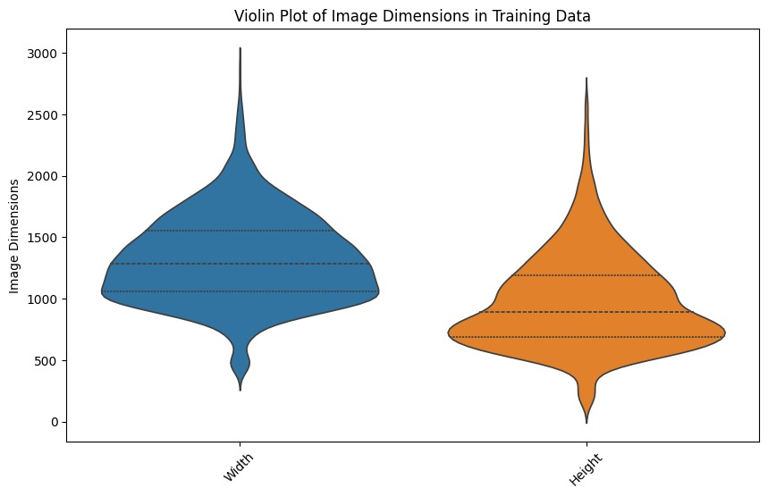
- Examining image dimensions through box plots and violin plots.

Slide 12
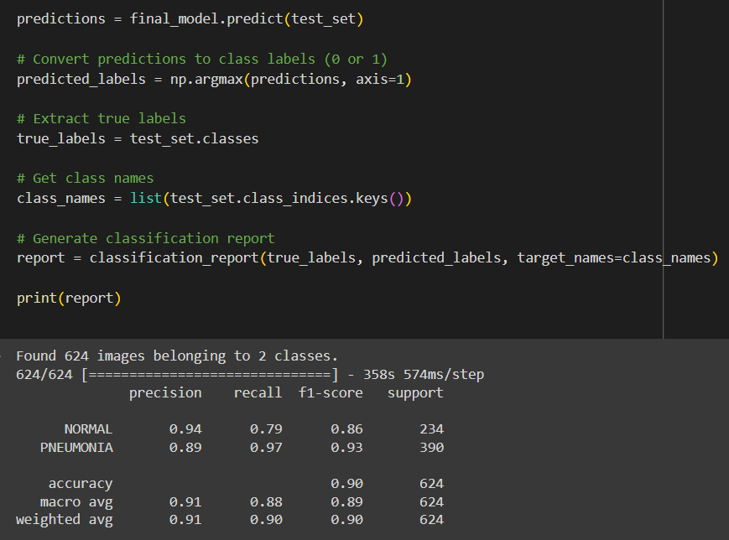
Model Evaluation
For model evaluation, we calculated various metrics including accuracy, precision, recall, and F1-score. Additionally, we generated a confusion matrix to visualize the model's performance in classifying normal and pneumonia cases.

Slide 13
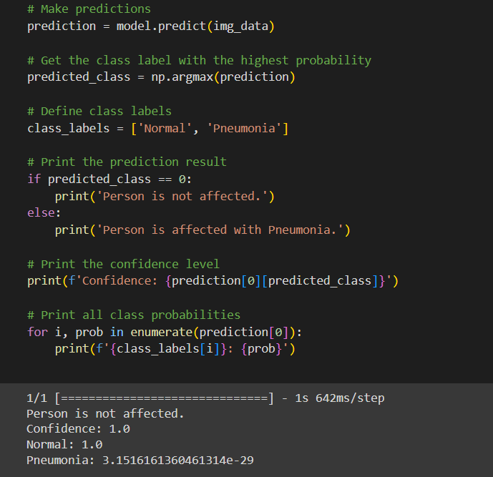
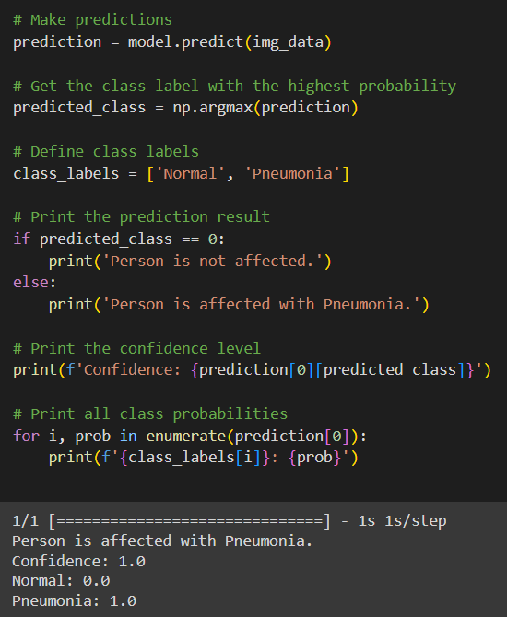

Slide 14
Conclusion
In conclusion, our analysis showcased the effectiveness of deep learning for chest X-ray image classification. Despite encountering challenges, our model demonstrated promising results. Future enhancements may involve exploring advanced architectures, optimizing hyperparameters, and incorporating additional data sources for improved performance.

Slide 15

–THANK YOU

